Slide 1

WiFi based safety Smart watch for coalmine workers
16BEC0449 - ROHAN ABHISHIKTH L
16BEC0024 - TEJA K
16BEC0451 - SARTAJ SINGH
Faculty mentor – Sivacoumar R (SENSE)

Slide 2
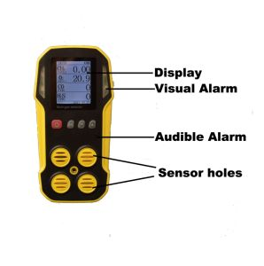
INTRODUCTION
The basic idea is to incorporate the concept of IoT and wifi based data transfer into the safety mechanisms currently used in the gas level monitoring systems (which are bulky and expensive) used in coalmines.

Slide 3
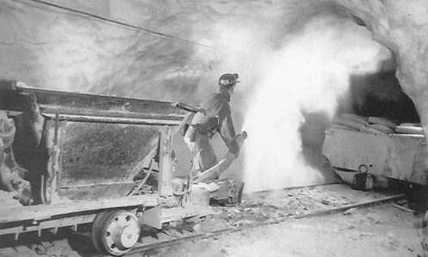
The threat here is the fact that the gasses produced in the work atmosphere of coalmines tend to ignite spontaneously due to the higher temperatures, making the workspace hazardous.
Our solution to this is to make a device such as a smart watch that is easily portable and gives the workers accurate inputs of gas concentrations around them, and also warning them to evacuate the area when the concentrations cross the threshold values of the safety norms. This would work with a server hub and its client, where the hubs monitor the data, analyse, compare and then transmit the data to be displayed on the screens of the client smart watches.

Slide 4
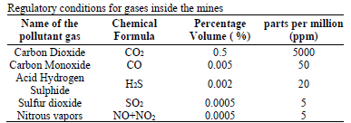
Coal mine safety hazards and norms

Slide 5
Logic Incorporated
Warning and evacuation message when gas concentration exceeds threshold value
A timer to time the duration of exposure to gases with TLV-STEL (threshold level value – short term exposure limit)
Multi server communication of a single client
To display concentrations of gases that are harmful at the temperature measured at the client

Slide 6
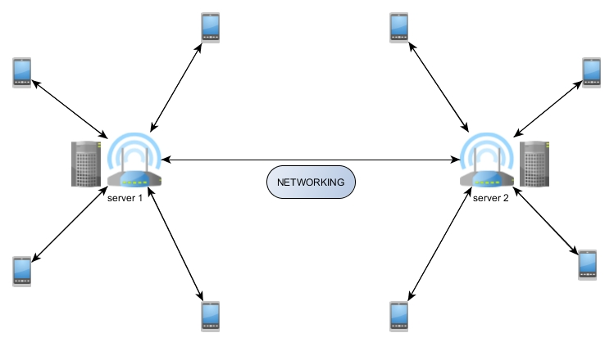
PRODUCT LAYOUT

Slide 7
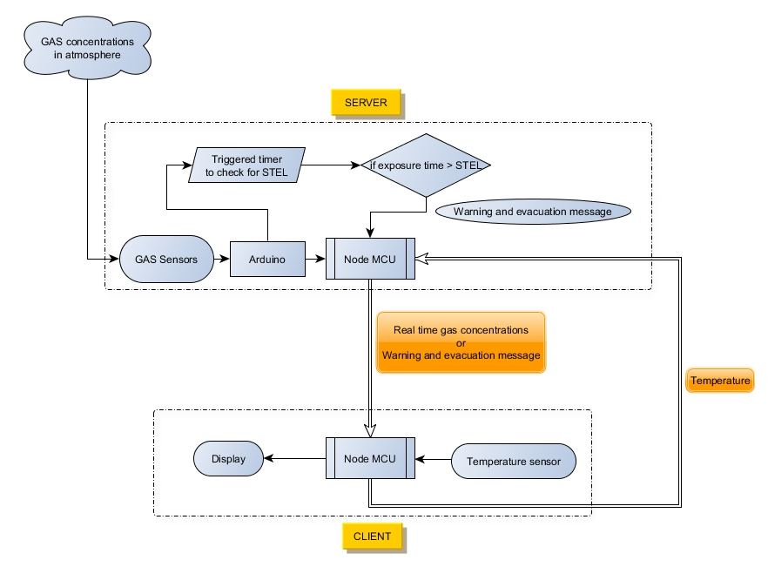
WORKING PRINCIPLE

Slide 8
THANK YOU

